Slide 1

Note: The data and information in this document is reflective of a hypothetical situation and client. This document is to be used for KPMG Virtual Internship purposes only.
Sprocket Central Pty Ltd
Data analytics approach
Judith Ononobor
Data Analytics Consulting Virtual Intern

Slide 2
Note: The data and information in this document is reflective of a hypothetical situation and client. This document is to be used for KPMG Virtual Internship purposes only.
Agenda
Introduction
Data Exploration
Interpretation

Slide 3
Note: The data and information in this document is reflective of a hypothetical situation and client. This document is to be used for KPMG Virtual Internship purposes only.
Introduction
CUSTOMER ANALYSIS
The features used for the analysis include:
Gender
Age distributions
Wealth Segments
Job Industry Category
Car Ownership

Slide 4
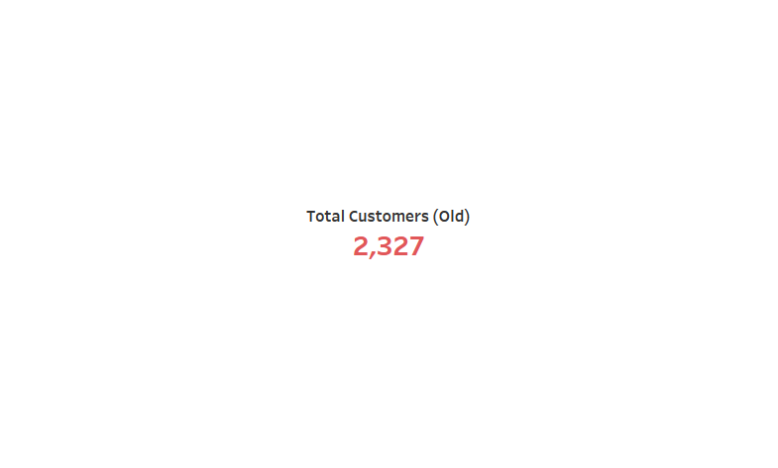
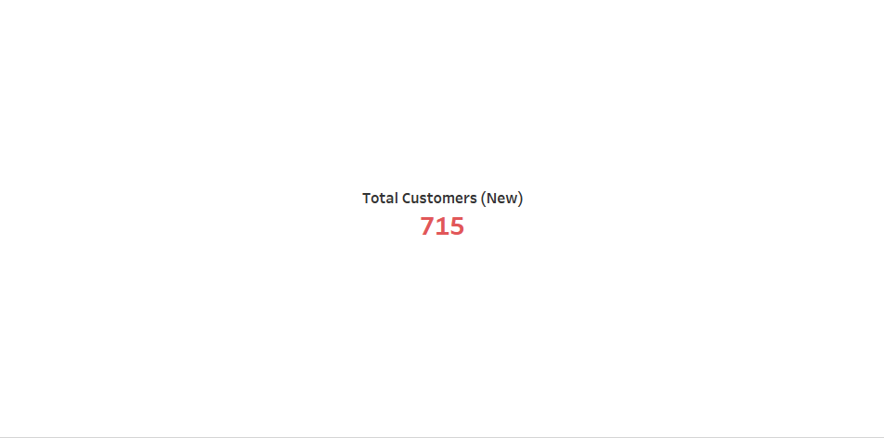
Note: The data and information in this document is reflective of a hypothetical situation and client. This document is to be used for KPMG Virtual Internship purposes only.
Data Exploration
TOTAL NO OF CUSTOMERS

Slide 5
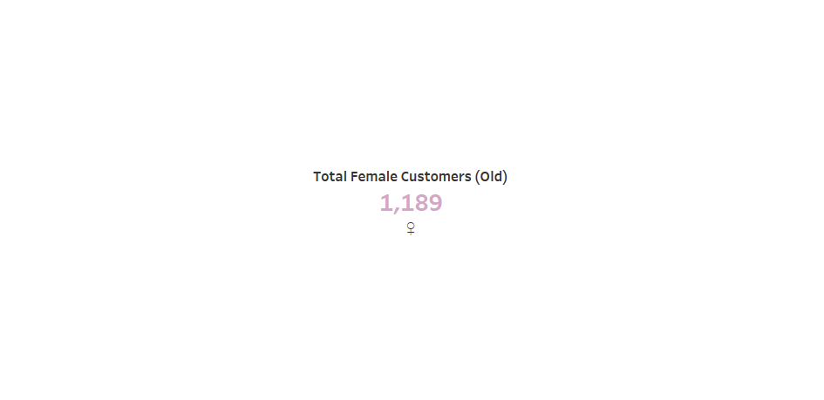
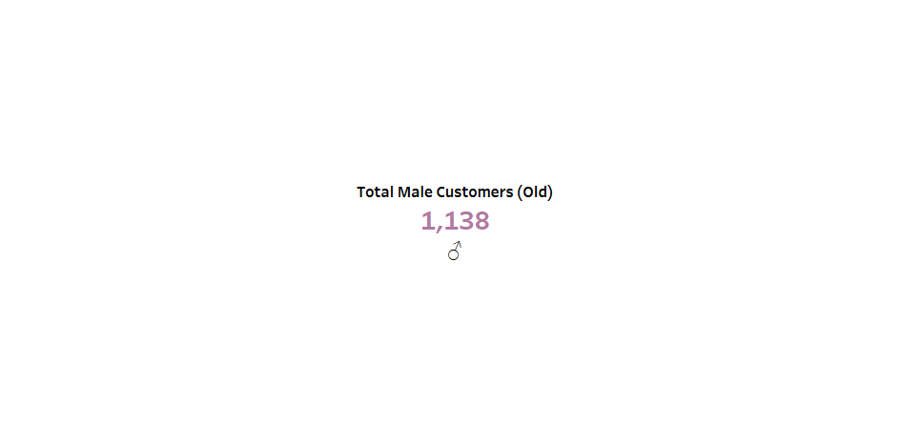
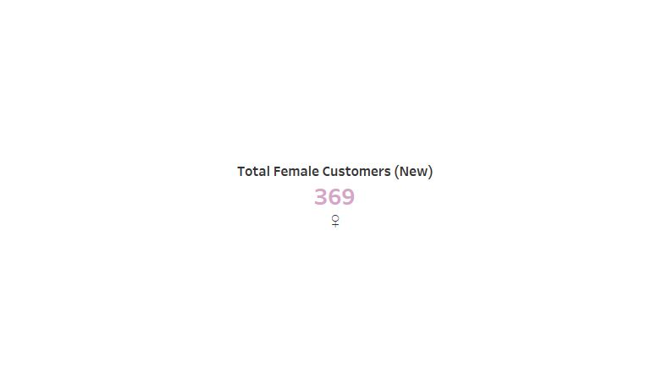
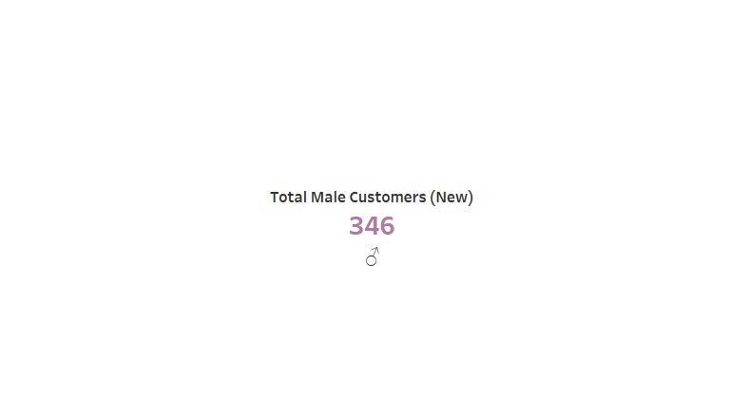
Note: The data and information in this document is reflective of a hypothetical situation and client. This document is to be used for KPMG Virtual Internship purposes only.
Data Exploration

Slide 6
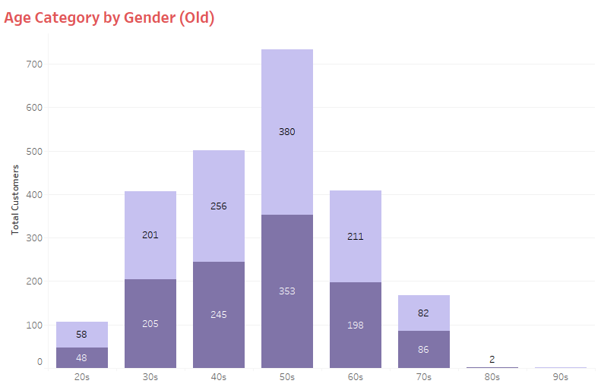

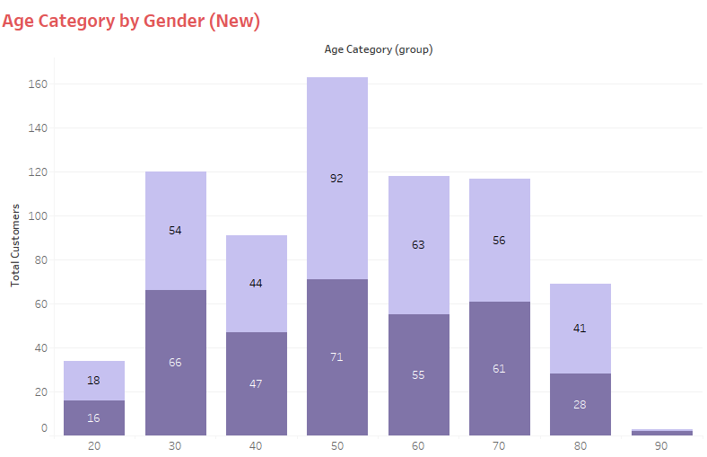
Note: The data and information in this document is reflective of a hypothetical situation and client. This document is to be used for KPMG Virtual Internship purposes only.
Data Exploration
AGE CATEGORY BY GENDER
Most customers, both male and female are in their 50s

Slide 7
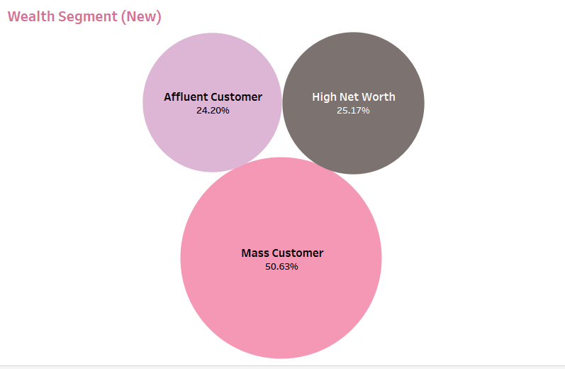
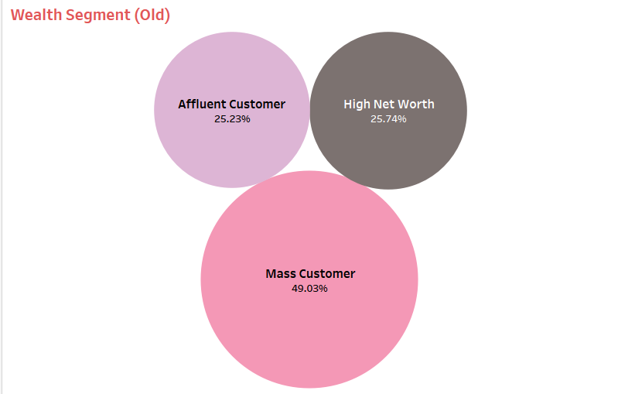
Note: The data and information in this document is reflective of a hypothetical situation and client. This document is to be used for KPMG Virtual Internship purposes only.
Data Exploration
WEALTH SEGMENT

Slide 8

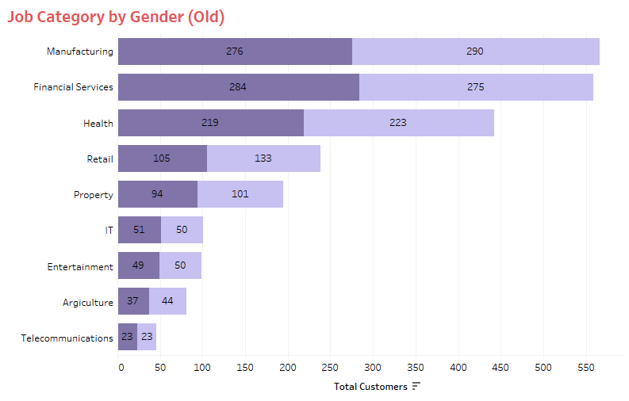
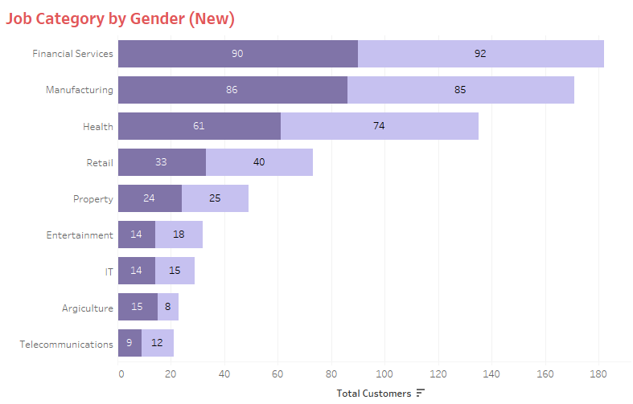
Note: The data and information in this document is reflective of a hypothetical situation and client. This document is to be used for KPMG Virtual Internship purposes only.
Data Exploration
Job Category by Gender
The top three industries are Financial services, Manufacturing and Health Industry.

Slide 9
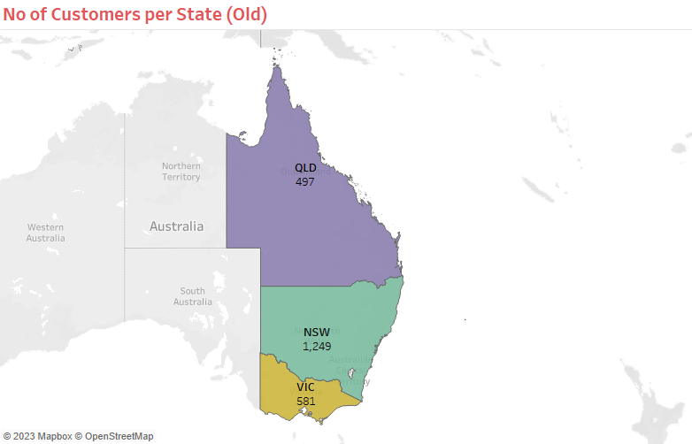
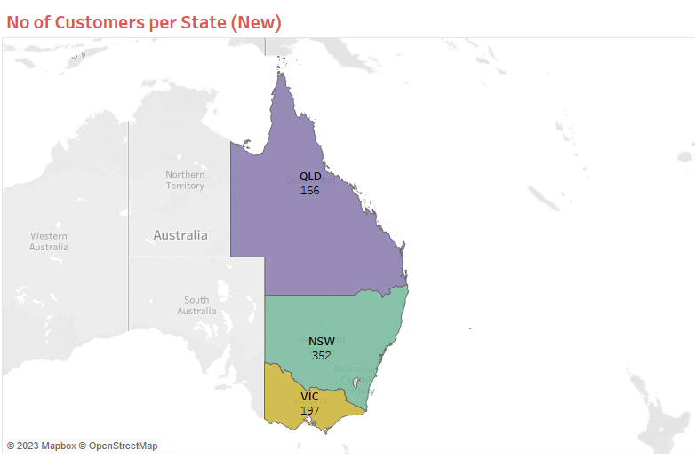
Note: The data and information in this document is reflective of a hypothetical situation and client. This document is to be used for KPMG Virtual Internship purposes only.
Data Exploration
No of Customers per State
Most customers reside in New South Wales for both

Slide 10

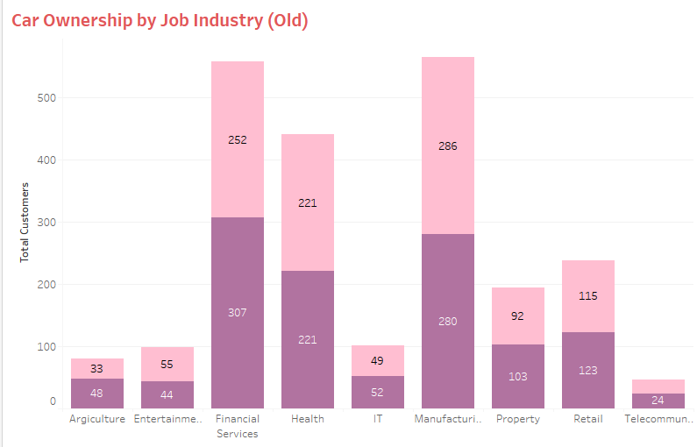
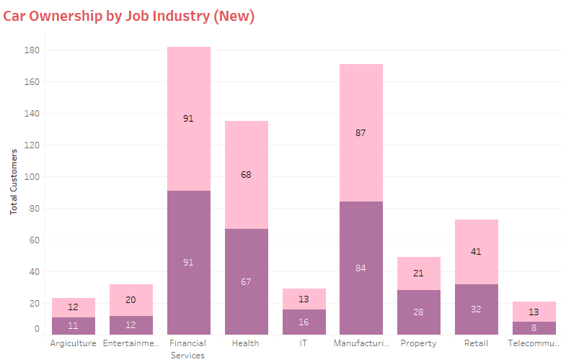
Note: The data and information in this document is reflective of a hypothetical situation and client. This document is to be used for KPMG Virtual Internship purposes only.
Data Exploration
Car Ownership by Job Industry
Customers who work in the top 3 industries own cars the most

Slide 11
Note: The data and information in this document is reflective of a hypothetical situation and client. This document is to be used for KPMG Virtual Internship purposes only.
Interpretation
The old customers share most similiarities with the new customers
There are more female customers.
Customers in their 50s are more in number
Top industries are the Manufacturing, Financial Services and Health.

Slide 12
Note: The data and information in this document is reflective of a hypothetical situation and client. This document is to be used for KPMG Virtual Internship purposes only.
Interpretation
Contd.
Customers in these top industries own cars more.
Most customers reside in NSW.
The top 1000 old customers can be gotten if these features are put in place.

Slide 13
Note: The data and information in this document is reflective of a hypothetical situation and client. This document is to be used for KPMG Virtual Internship purposes only.
Appendix

Slide 14
Note: The data and information in this document is reflective of a hypothetical situation and client. This document is to be used for KPMG Virtual Internship purposes only.
Appendix
Data Source
https://cdn-assets.theforage.com/vinternship_modules/kpmg_data_analytics/KPMG_VI_New_raw_data_update_final.xlsx

